Slide 1

VISVESVARAYA TECHNOLOGICAL UNIVERSITY
JnanaSangama, BELGAUM
BACHELOR OF ENGINEERING in MECHANICAL ENGINEERING
By
Himanshu Sharma 1ds14me055
Prathik Kamath 1ds14me060
Rojin 1ds14me117
Kumar Gaurav 1ds14me062
Under the guidance of
Mr. Kishore Kumar
Professor, Dept. of Mechanical Eng.
DAYANANDA SAGAR COLLEGE OF ENGINEERING, Bangalore
Department of Mechanical Engineering
DAYANANDA SAGAR COLLEGE OF ENGINEERING
SHAVIGE MALLESHWARA HILLS, KUMARSWAMY LAYOUT, BANGALORE-78
Accredited by National Assessment and Accreditation Council (NAAC) with ‘A’ grade
2017-2018

Slide 2
Design and Analysis of an E-BIKE Chassis frame

Slide 3
Abstract
In this various type of chassis are being designed, analyzed and optimized to give the manufacture a stable working chassis.
The several components will be analyzed separately instead of as a whole and, in some cases, the reaction forces in boundary areas of some parts will be used as external loads in other ones.
The structural analysis will be comprised of static and dynamic simulations for all the components and buckling analysis for parts under compressive loads.
The method applied for this structural analysis will be the finite element method in the Hypermesh for preprocessing, ANSYS workbench for processing and post processing whose CAD functions will also be used in order to provide alternate geometries for the motorcycle.

Slide 4
Introduction
What is Sustainable Automotive Engineering?
New Trends in Automotive Industry and increased need for alternate sources of fuel.
What is an E-Bike?
What is the purpose of a chassis?
Importance of chassis Design.

Slide 5
Objective
To design and analyze an Electric Vehicle Chassis frame.

Slide 6
Specific Objectives
To lay a groundwork and research about various types of chassis.
To understand which material is the best for the chassis frame.
Figure out how different an Electric Vehicle chassis is when compared to the Fuel Operated ones.
Choose and Design an optimum chassis frame.
Undertake different types of Analysis on the chassis to make it industry ready.
Structural Analysis
Non linear Analysis
Crash Analysis
Elastoplastic analysis
Fatigue Analysis
Vibrational Analysis

Slide 7
Literature Review
In order to successfully compete our task, various types of bike chassis must be considered and after applying various boundary conditions and loads an optimum chassis frame must be designed and analyzed under various conditions.
To understand the concept in depth the following literature was used.
Motorcycle Handling and Chassis Design by Tony Foale.
Motorcycle Chassis Analysis IDMEC/IST, Institute of Mechanical Engineering, Instituto Superior Técnico, University of Lisbon, Portugal
MODELLING AND STRUCTURAL ANALYSIS OF TWO WHEELER FRAME
YMCA Institute of Engineering, Faridabad, Haryana
A Review on Design and Analysis of Two Wheeler Chassis
Professor Ram Meghe Institute of Technology & Reasearch Badnera, Amravati,India.
Static and Dynamic properties of a motorcycle frame M. Bocciolone, F. Cheli, M. Pezzola & R. Viganò Department of Mechanical Engineering, Politecnico di Milano

Slide 8
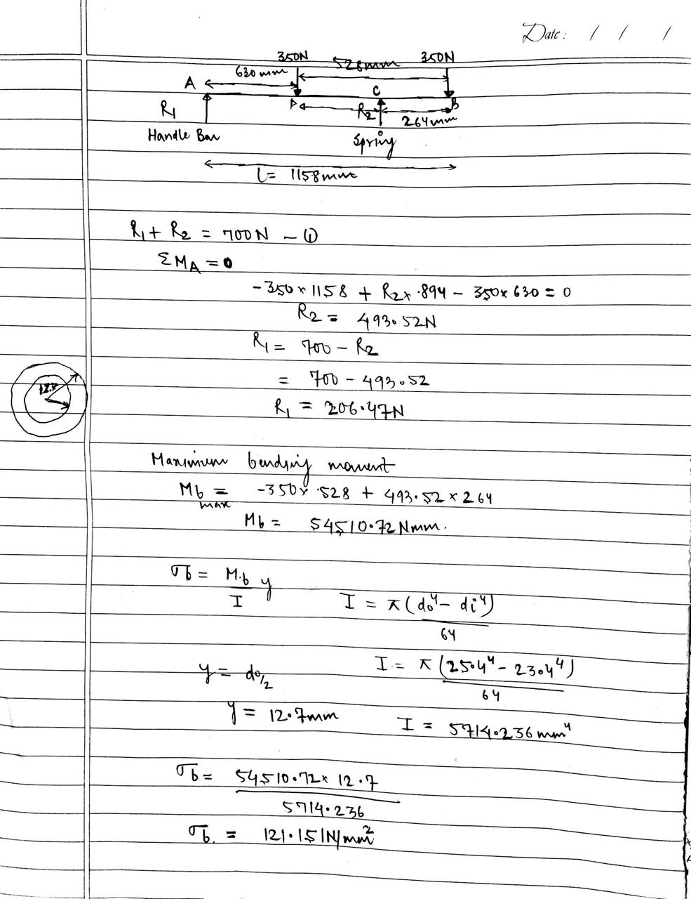
Analytical Solution
The cross section were obtained from market standard pipes available.
Outer diameter= 25.4mm
Inner Diameter= 23.4mm
From these calculations we found out that the cross section chosen is applicable for best performance.

Slide 9
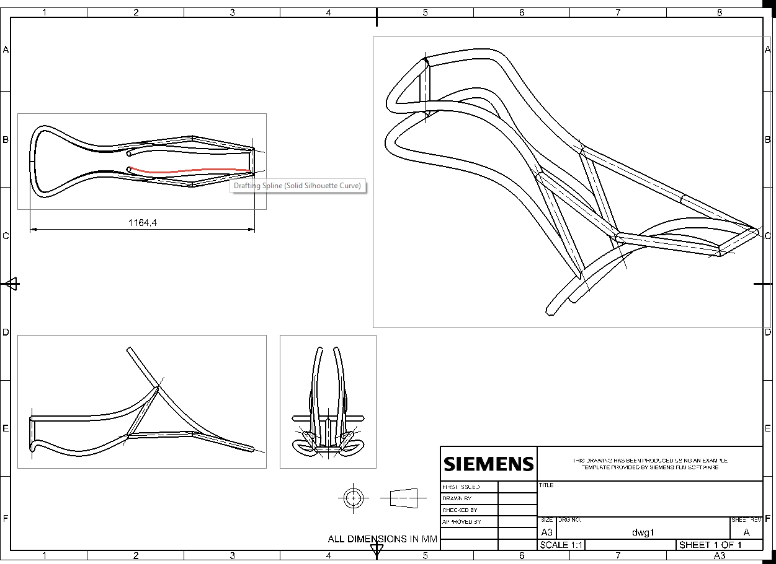
Design of the chassis
After thorough research work and considering various factors like cost,stability and feasibility, a final chassis was designed and all the tests and analysis are done on the same.
Final Design Various Designs of Chassis.pptx

Slide 10
Assumptions for Designing the Model
Material properties are isotropic.
Swing arm is modelled just give the real time approximation in the assembly by giving proper location for supports.
Spring element is used to simplify the modelling without using damping properties as dynamic loading is not considered.
One node is fixed in the handle bar bearing region to avoid solver pivotal errors.

Slide 11
Engineering Tables
Material selected : Aluminum 6061 T6
Material Properties
T6 temper 6061 has an ultimate tensile strength of at least 290 MPa (42,000 psi) and yield strength of at least 240 MPa (35,000 psi).
Aluminum 6061 t6 has one-third the density and one-third the modulus of steel – the diameter of the aluminum bar needs to be larger by 32 per cent, at which its weight will be only 58 per cent of that of the steel bar.
Cost is comparably low.
6061 is highly weldable, for example using tungsten inert gas welding (TIG) or metal inert gas welding (MIG).
6061 has good fatigue behavior with fatigue strength of 125 mpa.

Slide 12
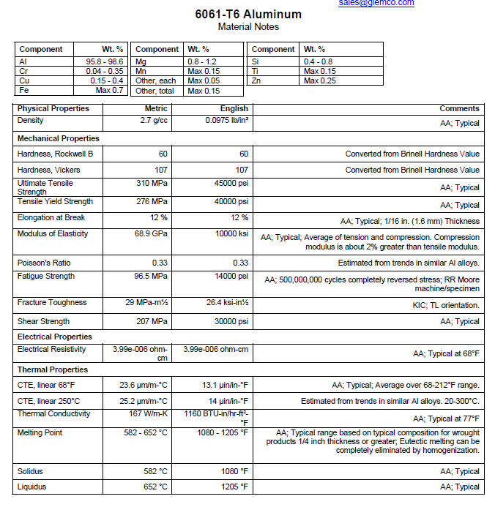
Material Property Report

Slide 13
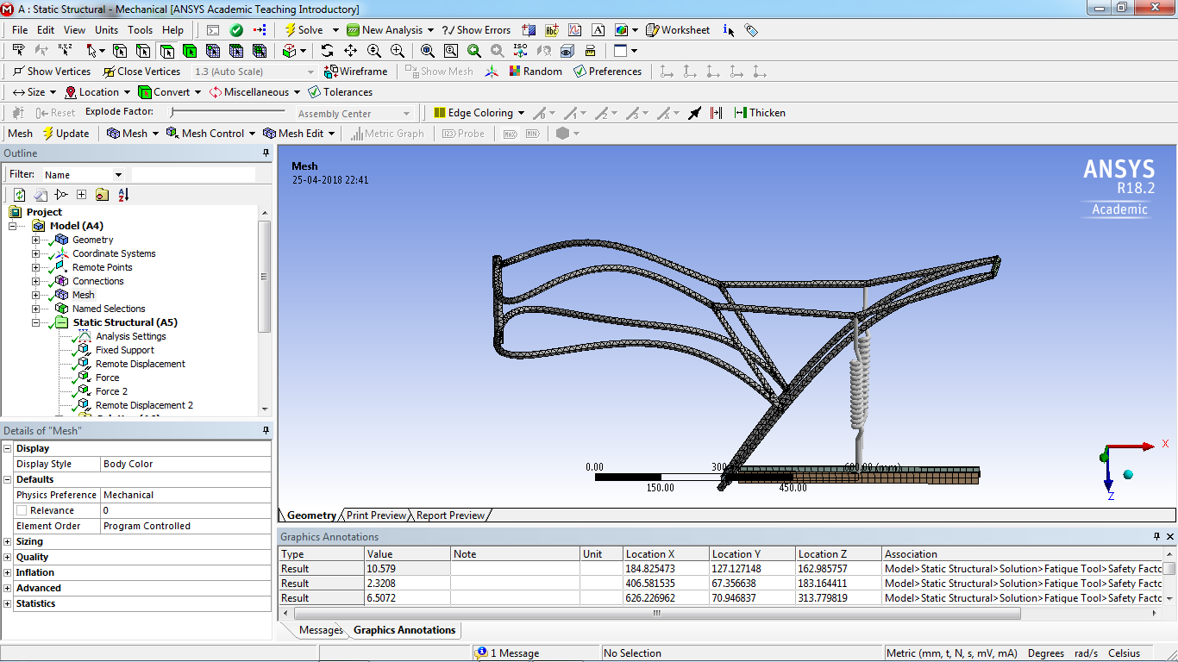
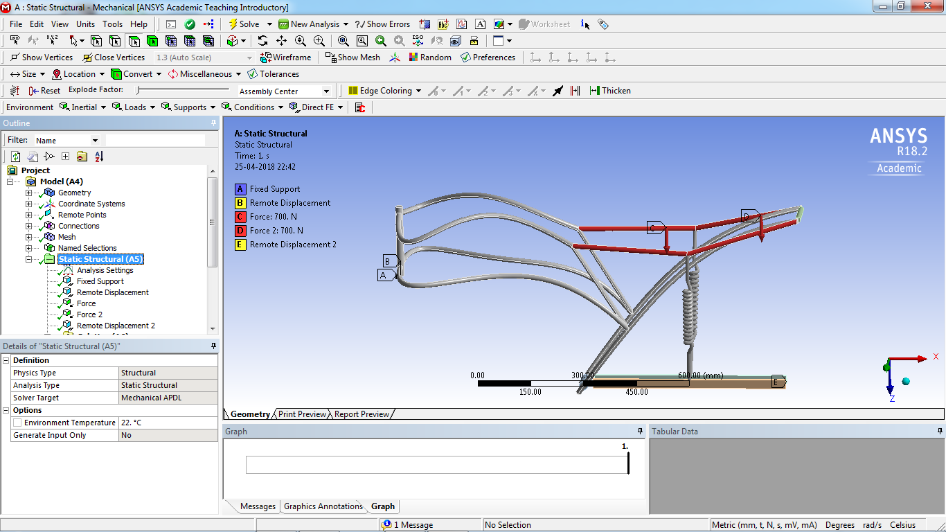
Static linear analysis
Meshed Model
Loading and boundary conditions

Slide 14
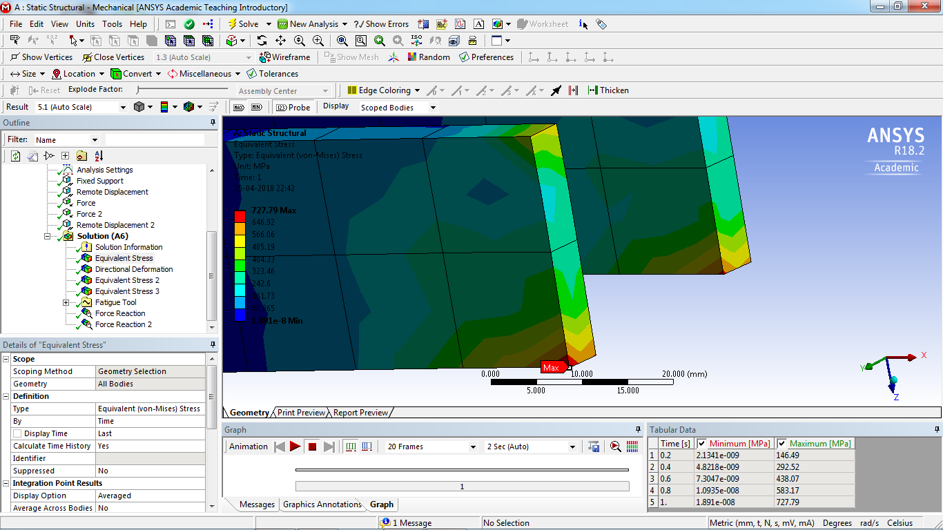
Localized Stress
Localized stress means the stresses those are generated at the surface or the subsurface due to any irregularity such as trapped cavity or cracks. This adds to the generated stress level. These stresses are generally considered as localized stress. It is generated due to any dysfunction at a local surface location.

Slide 15
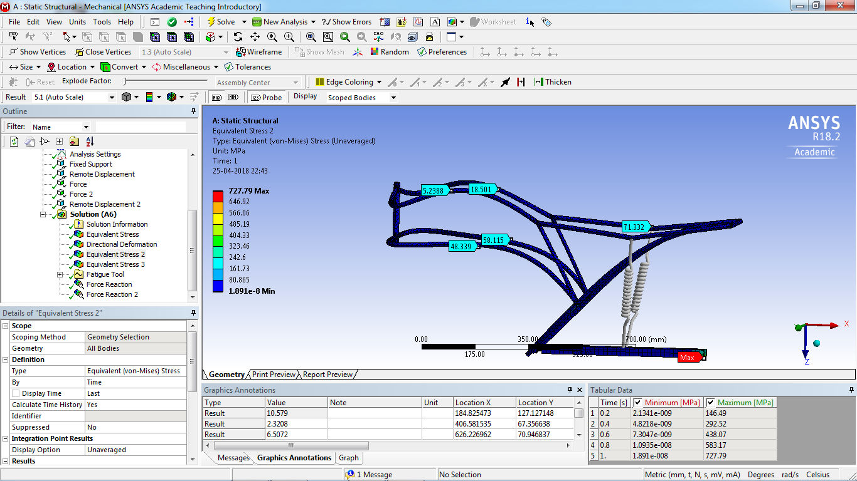
Unaveraged Stress
Unaveraged stresses are taken in order to check the mesh sensitivity.

Slide 16
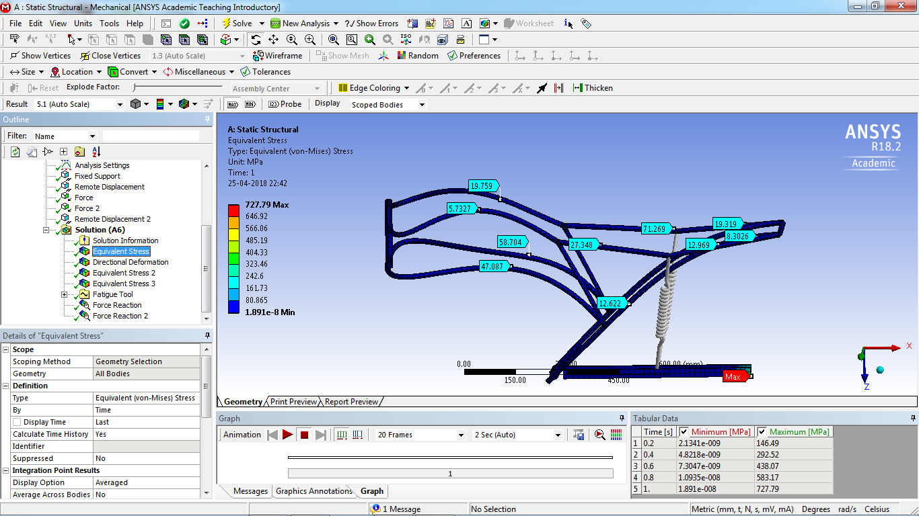
Result

Slide 17
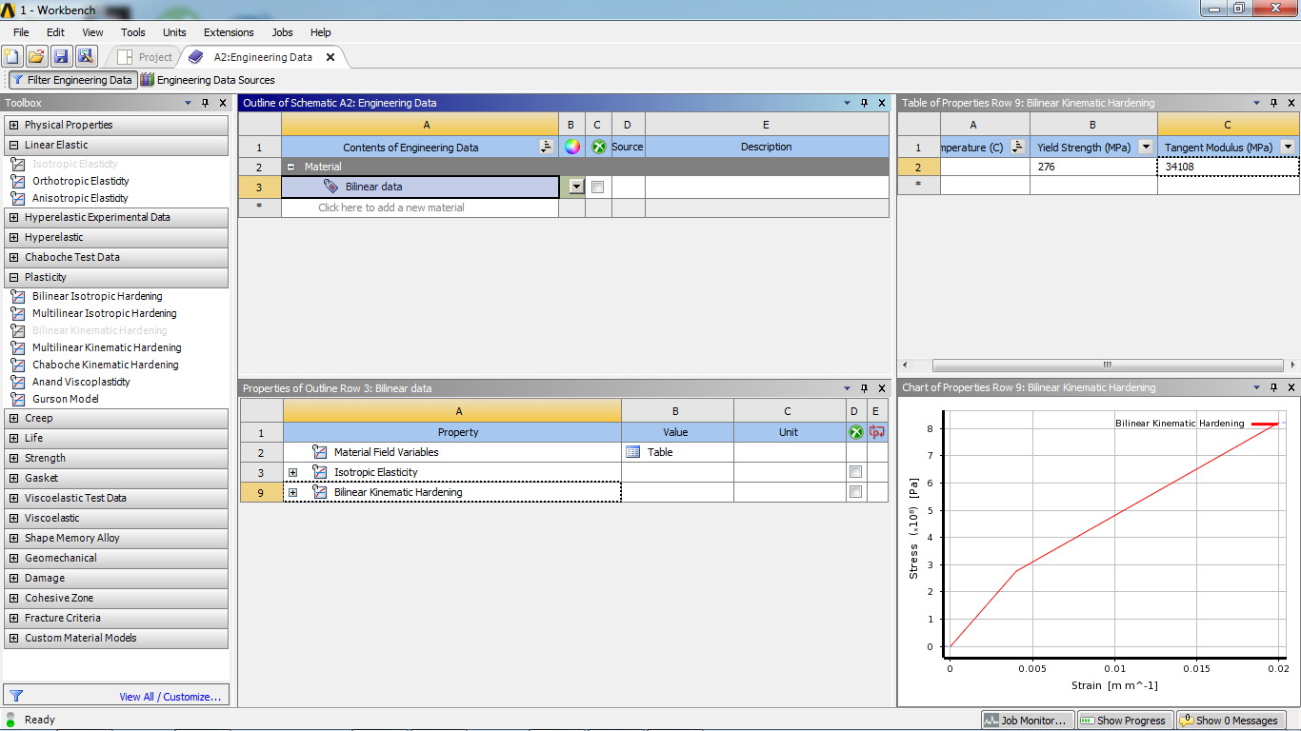
Non linear (Elasto Plastic Analysis)
Material Properties

Slide 18
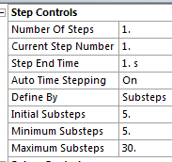
Meshed Model
Loading and Boundary Conditions
Settings for Non-Linear Controls

Slide 19
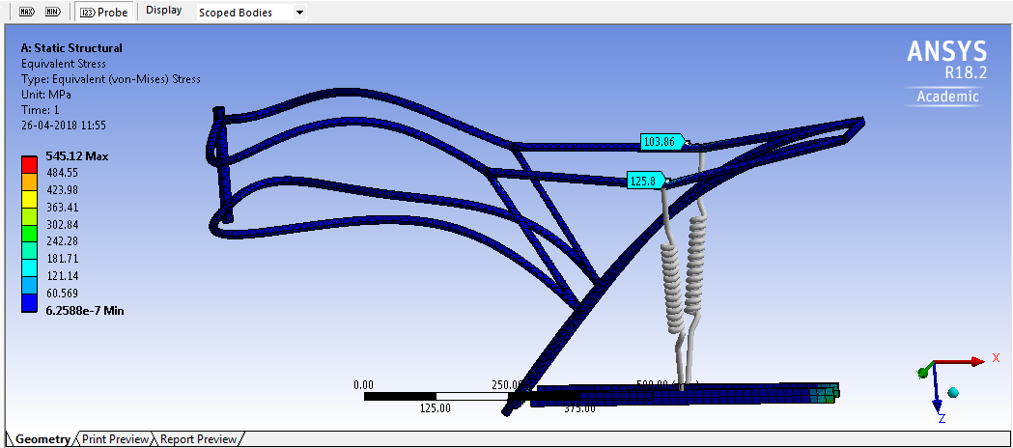
Result

Slide 20
Fatigue analysis
Loading and Boundary Conditions

Slide 21
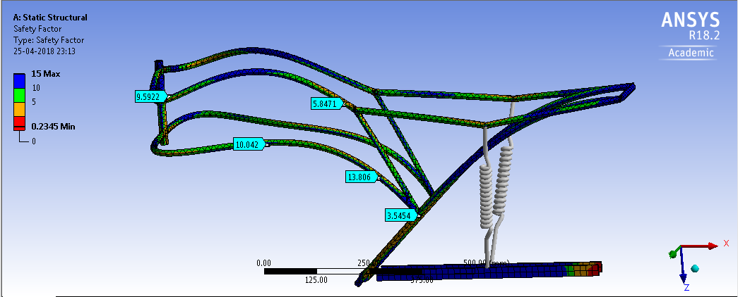
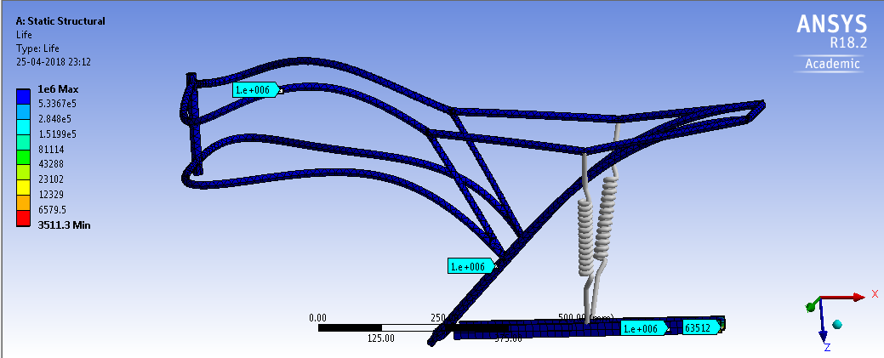
Safety Factor
Life

Slide 22
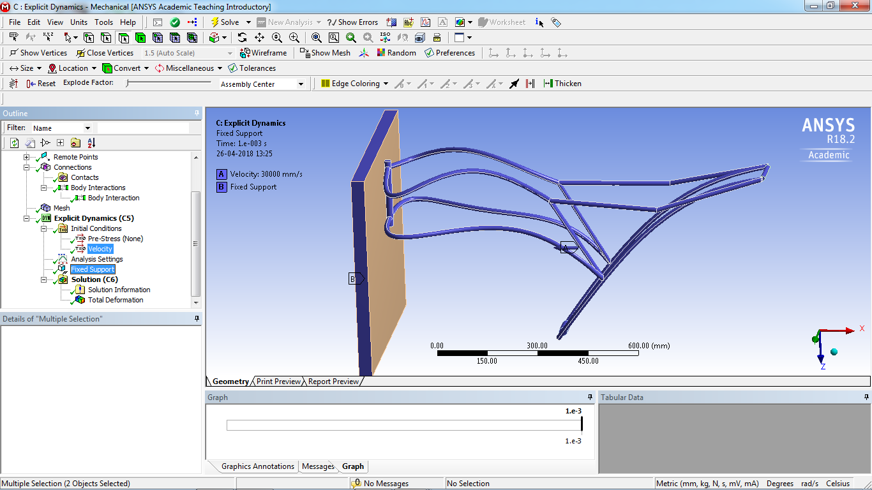
Crash Analysis
Loading and Boundry Conditions

Slide 23
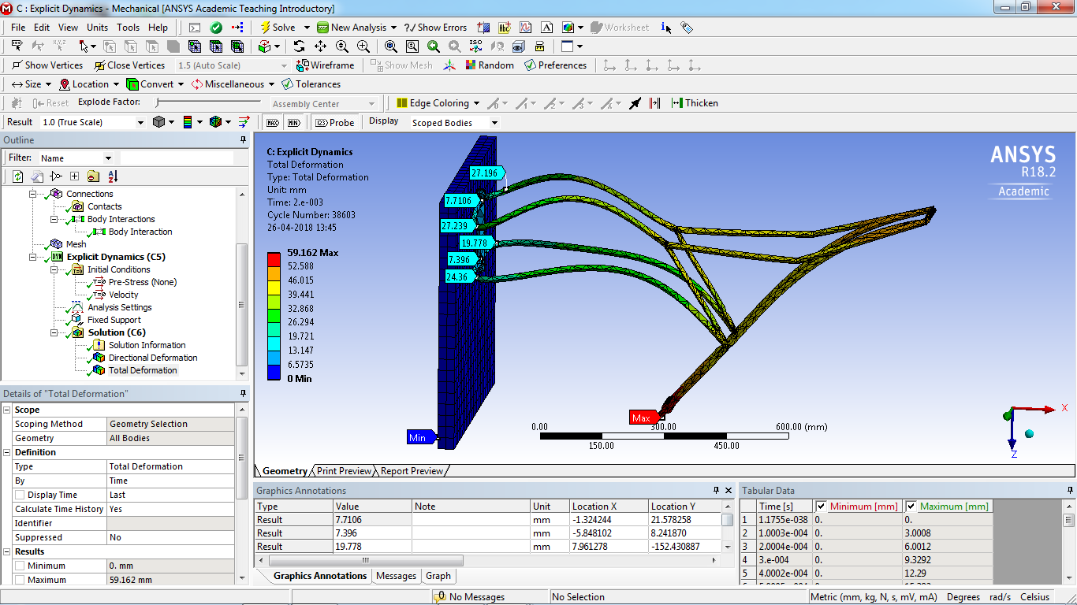
Deformed Model

Slide 24
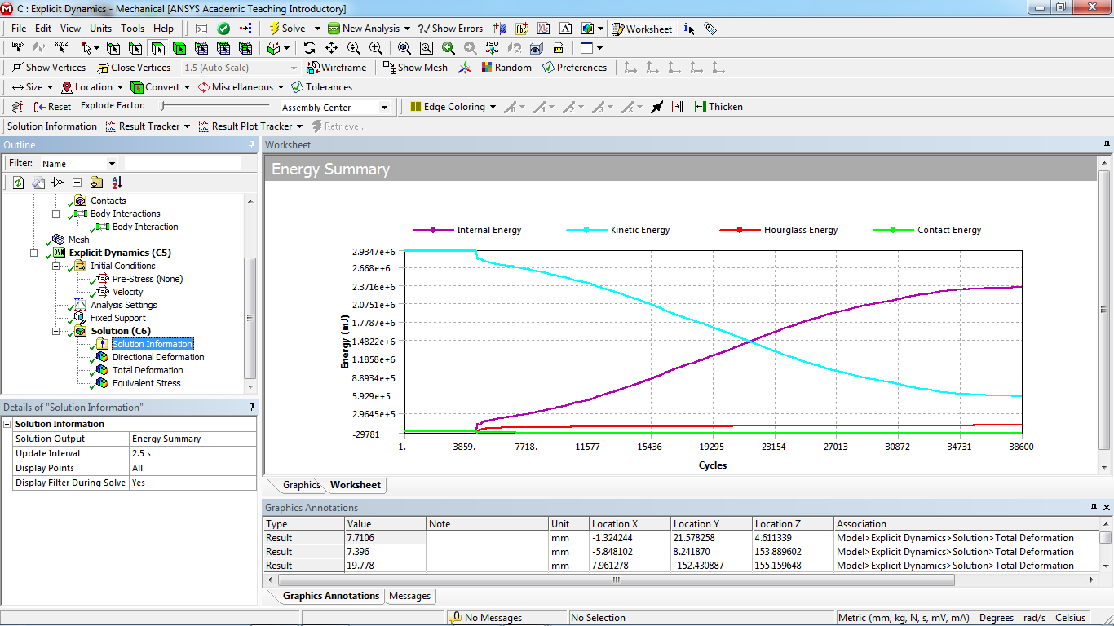
Energy Summary

Slide 25
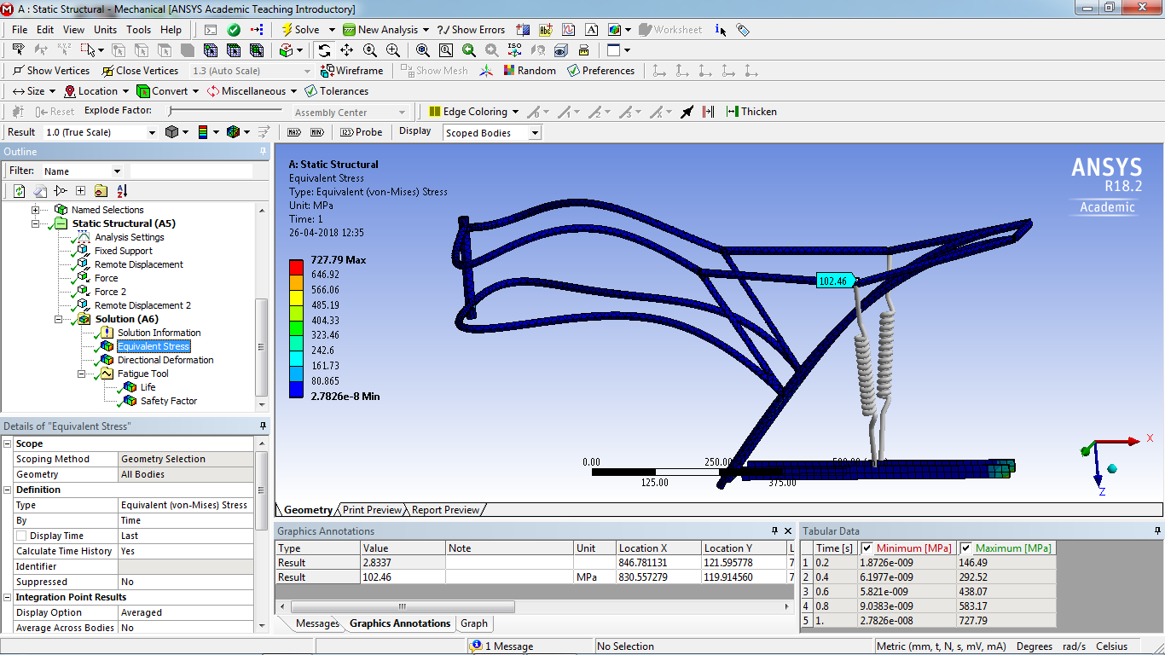
Factor of safety(Static)
Working Stress = 102.46*2 =204.9 Mpa
Yield Strength = 278Mpa
FOS = 278/204.9
= 1.25

Slide 26
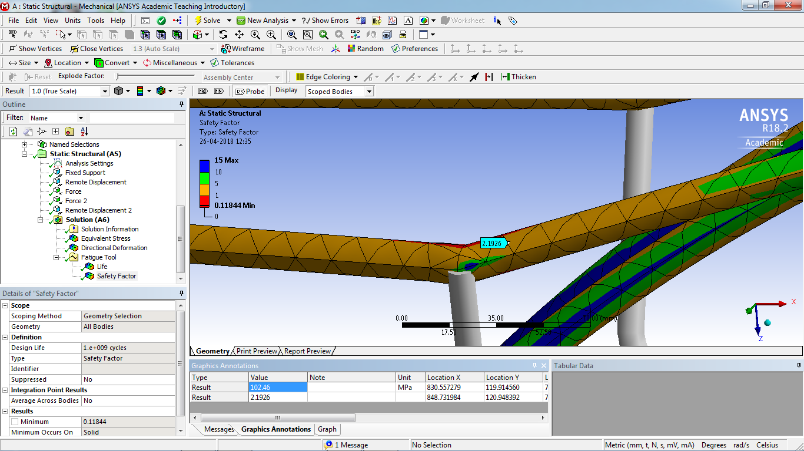
Factor of safety(Fatigue)
For stationary bike FOS=2.2
For Dynamic Travelling conditions FOS= 2.2/2=1.1

Slide 27
Observations
The chassis design in static analyses shows a working stress of 110Mpa well within the yield point, but we can scale the number *2 for conversion of dynamic loads to static loads & still having a FOS of 1.26
Exact numbers of stress values are obtained in non linear analysis just to be on the conservative side just in case of geometric non linarites like stress stiffening.
The designed chassis can survive in high cycle fatigue thus infinite life
The deformations of the chassis with frontal impact test at different speeds shows that the critical part i.e. the location of the battery is not disturbed.

Slide 28
Expected Outcomes
To be ready with an entirely new and feasible chassis frame.
To efficiently perform various Analysis of the newly designed Chassis frame.
To provide the required stability to the Chassis frame.
To make sure that the design is standardized and approved by the manufacturer.

Slide 29
Engineering Learning
Product Development
Material Selection
Calculating Analytical solutions using Strength of materials.
Working under Industry standards.
Collecting data for loading conditions from various sources
In depth learning of Finite Element Analysis.
Introduction to various softwares like
Catia
Unigraphics
ANSYS Workbench
Project Management

Slide 30
References
www.iosrjournals.org/iosr-jmce/papers/vol11-issue4/Version-3/J011435659.pdf
http://www.capalex.co.uk/standards/round_tubes.html
https://www.motorcyclistonline.com/ducati-desmosedici-rr-85-percent-solution
http://doras.dcu.ie/19502/1/Ping_Hwa_20130725155530.pdf
http://www.amesweb.info/Materials/Aluminum-6061-Properties.aspx
https://www.makeitfrom.com/material-properties/SAE-AISI-4130-SCM430-1.7218-25CrMo4-G41300-Cr-Mo-Steel

